Slide 1
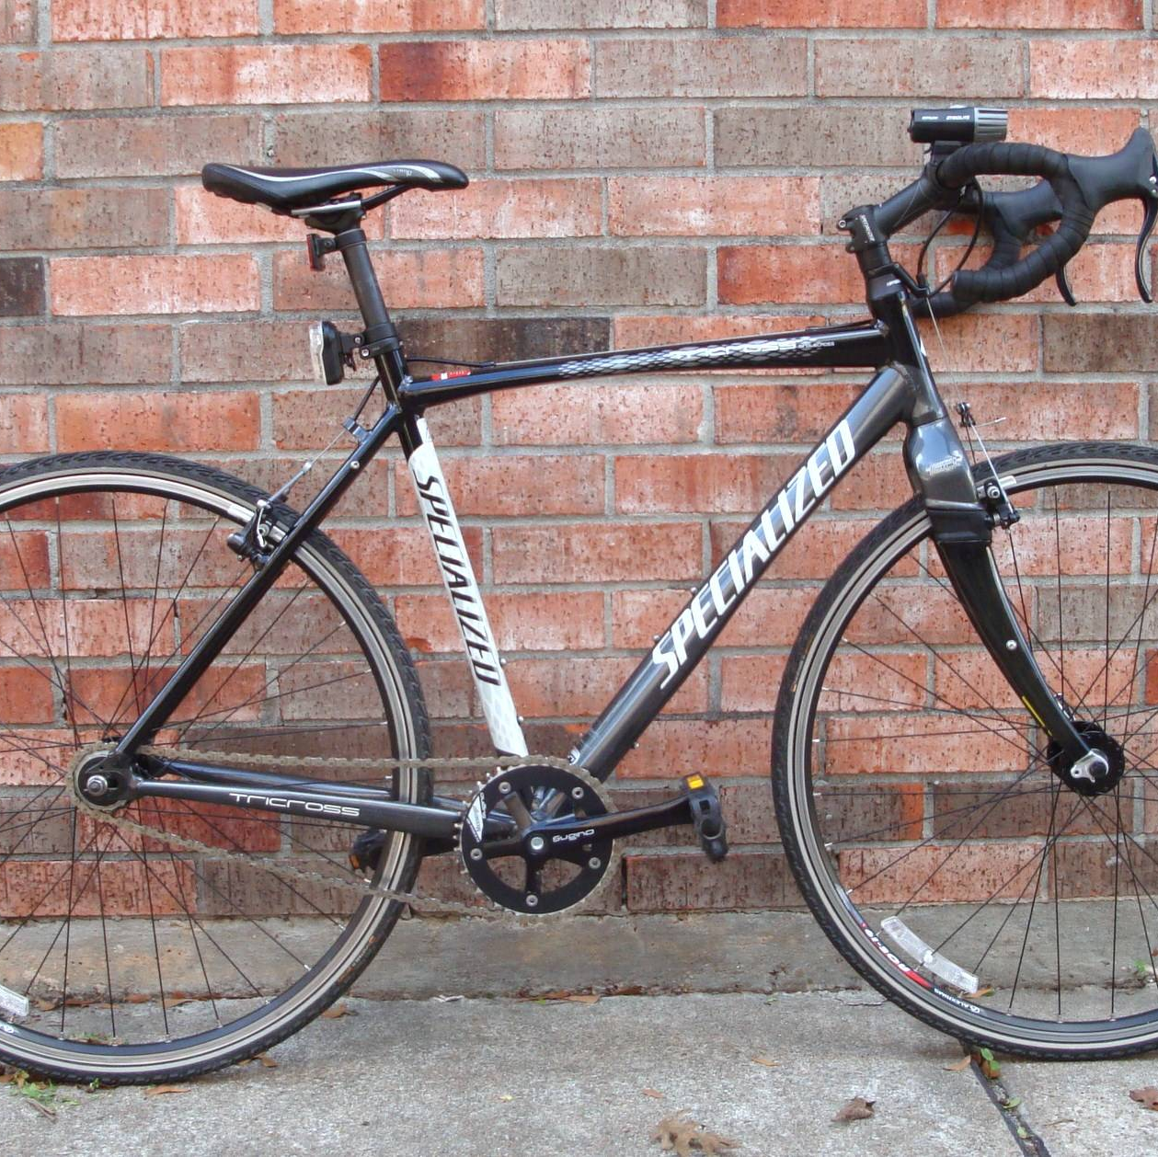
CyCLSTIC GOOGLE PROYECT
Author: christian calvanese
7/18/2022

Slide 2
Background
In 2016, Cyclistic launched a successful bike-share offering. Since then, the program has grown to a fleet of 5,824 bicycles that are geotracked and locked into a network of 692 stations across Chicago. The bikes can be unlocked from one station and returned to any other station in the system anytime.
There are two types of cyclist, those who purchase casual tickets and those who purchase annual memberships. The marketing team believes that maximizing the number of annual members will be key to future growth. Rather than creating a marketing campaign that targets all-new customers, there is a very good chance to convert casual riders into members.

Slide 3
Problem
What is the most effective marketing strategy for converting Cyclistic’s casual riders to annual memberships?
How do annual members and casual riders use Cyclistic bikes differently?
How can Cyclistic use digital media to influence casual riders to become members?

Slide 4
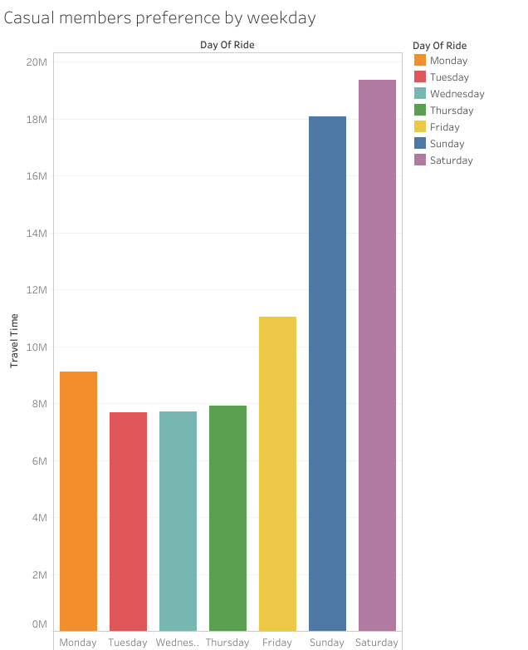
What does the data tell us?
Our target (casual members) tend to use the service more frequently on weekends.

Slide 5
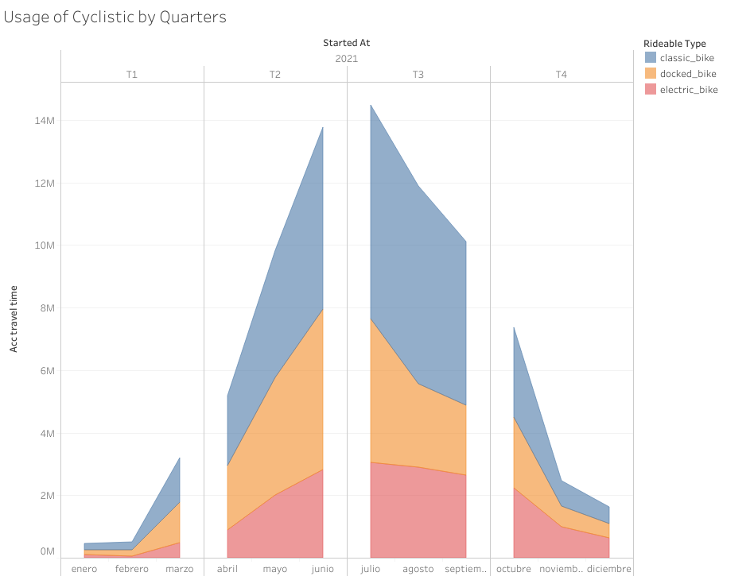
What does the data tell us?
The stational usage of the service increase greatly between April until September, which is the summer season in Chicago.

Slide 6
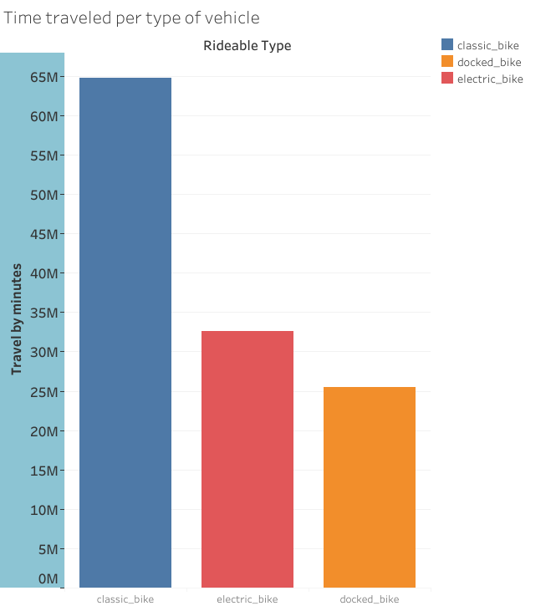
What does the data tell us?
The users prefer the classic bike between the tree choices of vehicle.

Slide 7
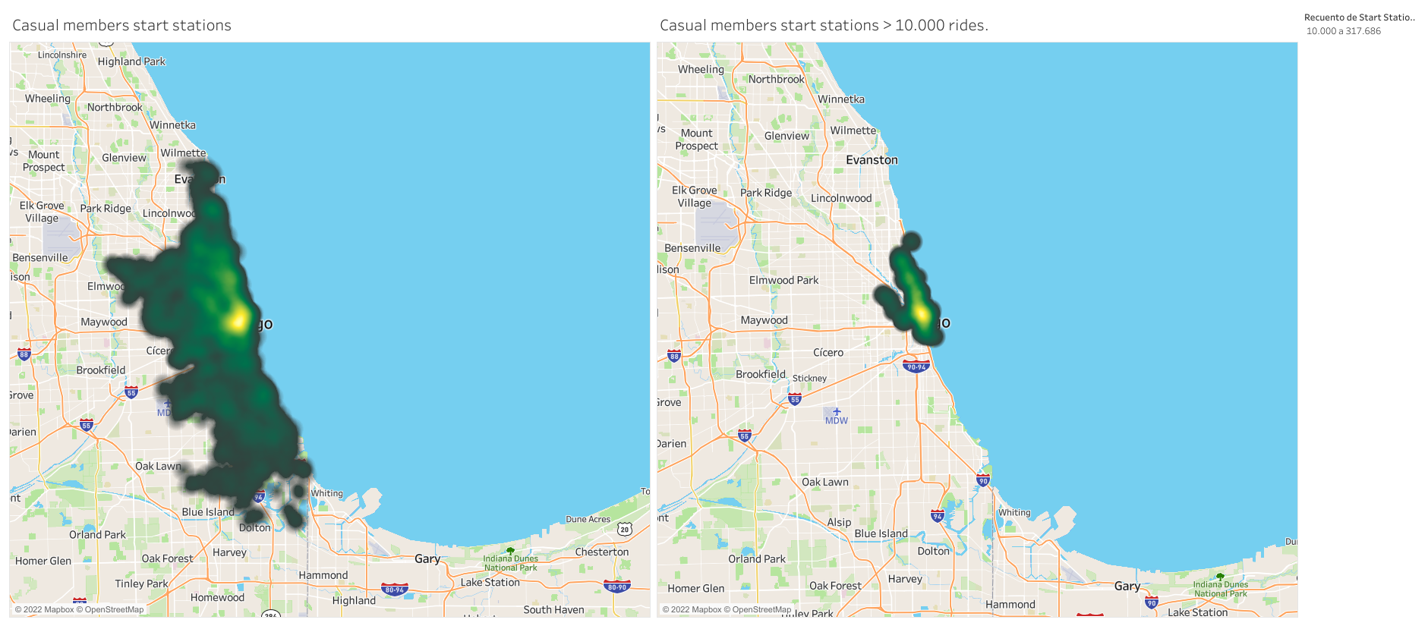
What does the data tell us?
Most of the stations are in midtown.
The most start rides occurs in the right map highlighted area.

Slide 8
Recommendations
In terms of seasons the on-site marketing should be primary on the weekends. They should also consider the timeframe between April to September. They can also consider counter marketing and trying to target the less active months and weekdays.
In terms of vehicle usage and customer experience the should reconsider the docked bikes, they are not very popular and can be a factor of choice between a being a member or just a casual.
In terms of digital media focus, the geolocalization points should be the area highlighted on the map in the right, and if this is combined with the higher usage seasons it can be an effective way of getting the casuals attention.

Slide 9
Things to consider
An age data input
A gender data input
The money spent on the app input
Since when they are casual members?
All this inputs could improve future analysis.

Slide 10
Thanks for watching !
If you want to reach me:
Github : https://github.com/Christiansito
Linkedin : https://www.linkedin.com/in/christian-calvanese-carril-985a3b70/?locale=en_US

